Slide 1
Organization Hierarchy Provider
A Presentation on:
by:
Pankaj

Slide 2
Problem Statement
A client wants report of entire organization hierarchy starting from CEO where manager and all his reportees will be printed on console in a tree like structure
All employee data should be read from file or database.

Slide 3
Feature List
We have to read the employee data from a source.
We should be able to build organization's hierarchy from the employee data.
We must print the hierarchy on console.

Slide 4
Use Case Diagram
System
Load Employee Data
Build Hierarchy
Service
Get Report
Client

Slide 5
Requirements
Load Employee Data
The admin supplies a file or database containing employee data.
The system reads in employee details.
The system maintains the details in a temporary list.
Build Hierarchy
The system reads in individual employee data.
The system makes manager-reporter relationship
The system repeats above steps for all employees

Slide 6
Requirements continued..
Get Report
The system reads in organization hierarchy.
Then, the system prints all employee’s details.

Slide 7
Domain Analysis
Nouns
Organization Employee Console Input
Client File Database System
Report CEO Manager Reportee
Verbs
Read Print Build Store
Find CEO

Slide 8
Class Diagram
AppHandlerService
org : Organisation
inputReader : InputReader
console : ConsolePrinter
Organisation
- employees : Map<Integer,Employee>
- ceo : Employee
+ start():void
+ buildHierarchy(List<EmpDTO>) : void
+ getCEO() : Employee
setCEO(Employee) : void
<< interface >>
InputReader
ConsolePrinter
Employee
+ read() : List<EmpDTO>
+ print(Employee) : void
id : int
name : String
managerId : int
reportees : List<Employee>
FileReader
DatabaseReader
+ getters()
+ setters()
+ toString() : String
- fileLocation : String
- databaseLocation : String
+ read():List<EmpDTO>
+ read():List<EmpDTO>

Slide 9
Design Patterns Used
Facade Pattern
AppHandlerService
org : Organisation
inputReader : InputReader
console : ConsolePrinter
+ start():void
Organisation
- employees : Map<Integer,Employee>
- ceo : Employee
<< interface >>
+ buildHierarchy(List<EmpDTO>) : void
+ getCEO() : Employee
setCEO(Employee) : void
InputReader
ConsolePrinter
+ read() : List<EmpDTO>
+ print(Employee) : void
Employee
id : int
name : String
managerId : int
reportees : List<Employee>
FileReader
DatabaseReader
- fileLocation : String
- databaseLocation : String
+ getters()
+ setters()
+ toString() : String
+ read():List<EmpDTO>
+ read():List<EmpDTO>

Slide 10
Design Patterns Continued..
Composite Pattern
Employee
id : int
name : String
managerId : int
reportees : List<Employee>
+ getters()
+ setters()
+ toString() : String

Slide 11
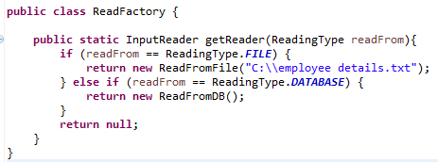
Design Patterns Continued..
Simple Factory Pattern

Slide 12
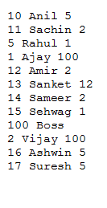
Example
A Temporary List
of employees
Employee Data
.
.
.
id:10
name :Anil
managerId:5
ReadFromFile
- fileLocation : String
id:11
name :Sachin
managerId:2
+ read():List<EmpDTO>
id:5
name :Rahul
managerId:1

Slide 13
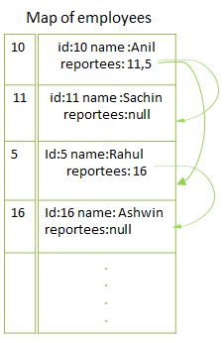
Example Continued..
A Temporary List
of employees
.
.
.
id:10
name :Anil
managerId:5
Organisation
id:11
name :Sachin
managerId:10
- employees : Map<Integer,Employee>
- ceo : Employee
+ buildHierarchy(List<EmpDTO>) : void
+ getCEO() : Employee
setCEO(Employee) : void
id:5
name :Rahul
managerId:10

Slide 14
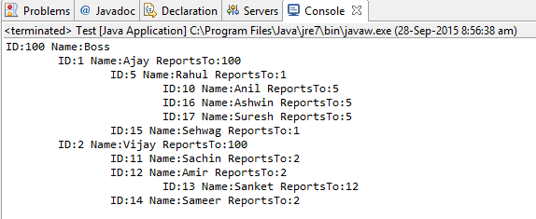
Example Continued..
ConsolePrinter
+ print(Employee) : void
Result

Slide 15
Thanks

